Slide 1
Time Series Prediction Using LSTM for a Sine wave
Preetam Shankar Malla

Slide 2
Introduction
A time series is a sequence of data points that are measured at successive time intervals predicting future values.
There are many approaches that can be used one such approach is to use a Long Short-Term memory(LSTM) network, this is a type of Recurrent Neural Network(RNN).
The LSTM network is trained on a time series dataset by feeding it input data one time step at a time and using the previous time steps to predict the next time step.
The time series prediction using Neural networks is a powerful approach for making prediction, it is possible to train and make reliable predictions about future values.

Slide 3
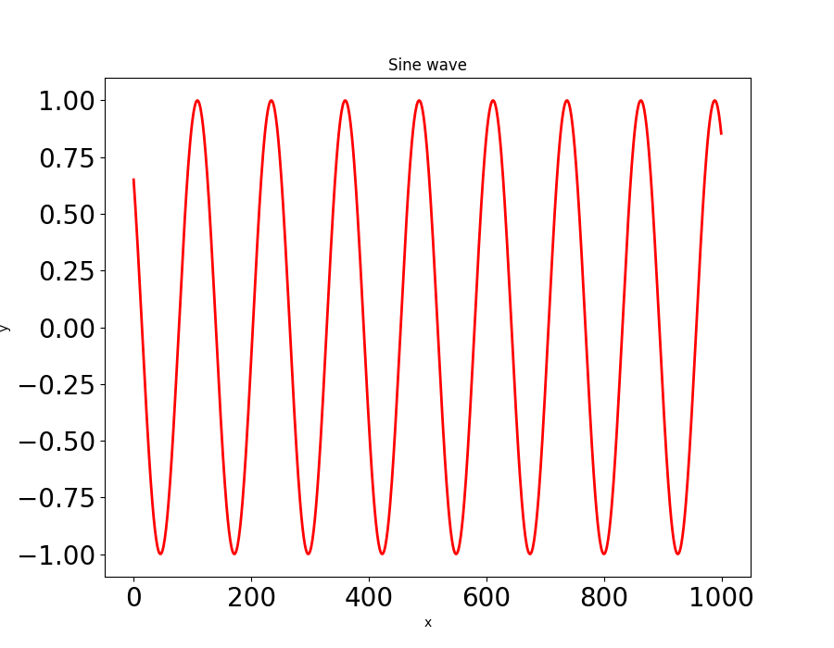
Data
To create a Sine wave we have created our own data by giving
Number of samples N = 100
Number of values for each sine wave and L = 1000
Width of the wave T = 20

Slide 4
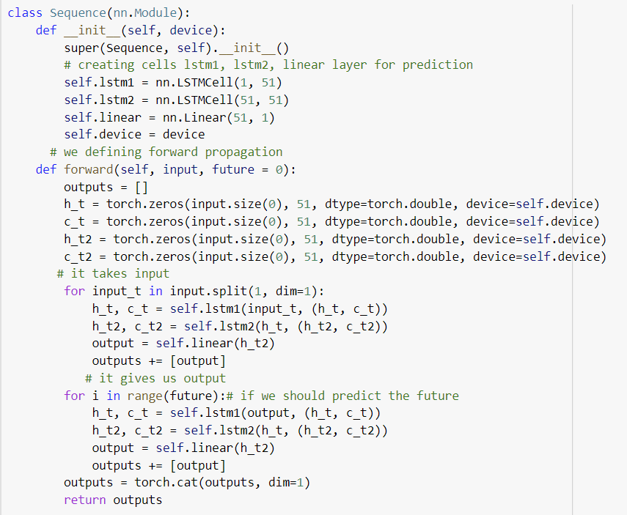
LSTM Model

Slide 5
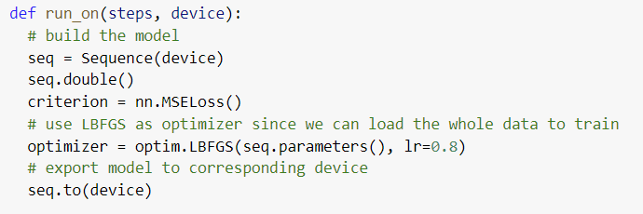
Metrics and Optimiser
It defines a loss function mean square error to reduce the loss we use LBFGS optimizer which will reduce the time significantly .

Slide 6
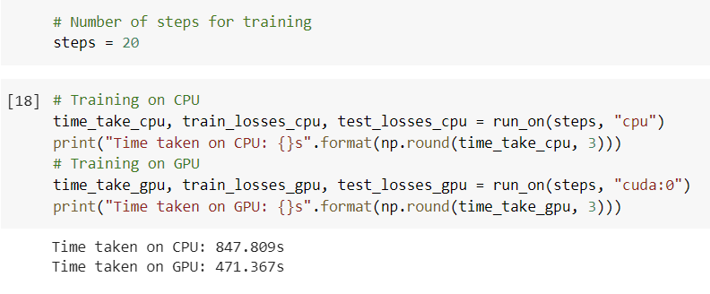
Training on CPU vs GPU
The Number of steps taken for training is 20 on CPU it took 847.809 seconds, which is equal to 14.13 minutes.
Whereas training the same 20 steps on GPU took 471.367 seconds, which is equal to 7.85 minutes.
It is clearly evident that training the model on GPU reduces the time to nearly half of the time take by the CPU.

Slide 7
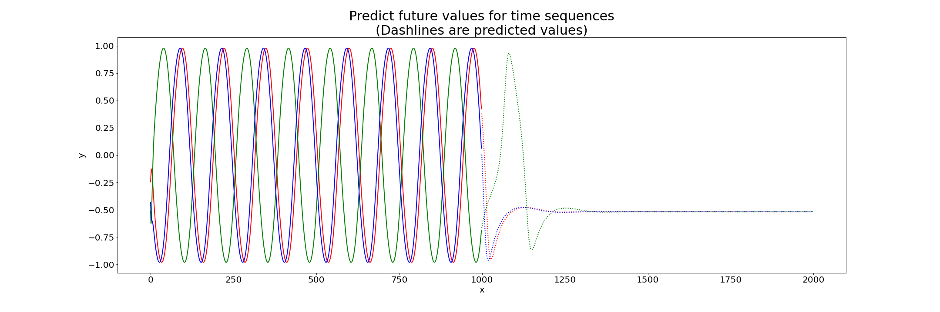
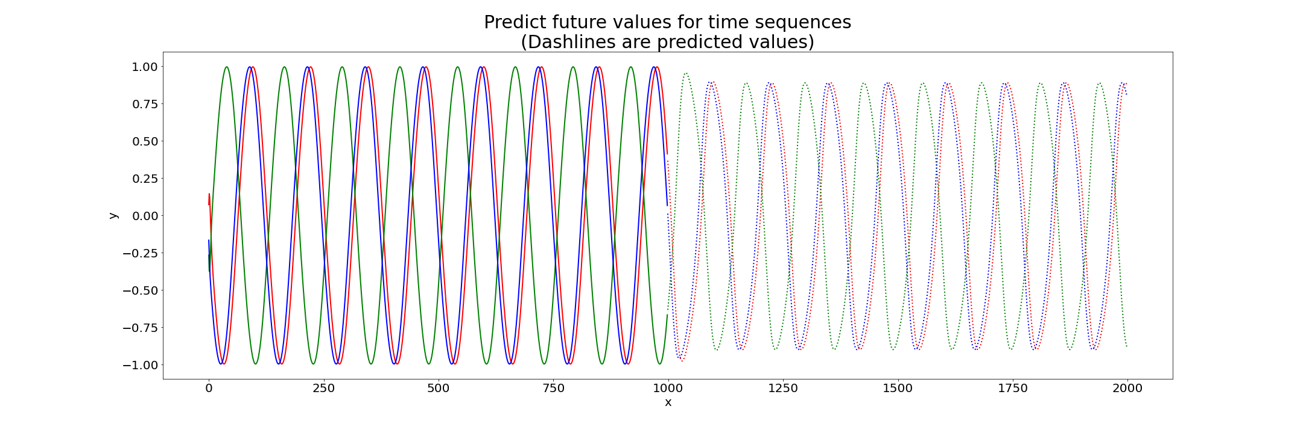
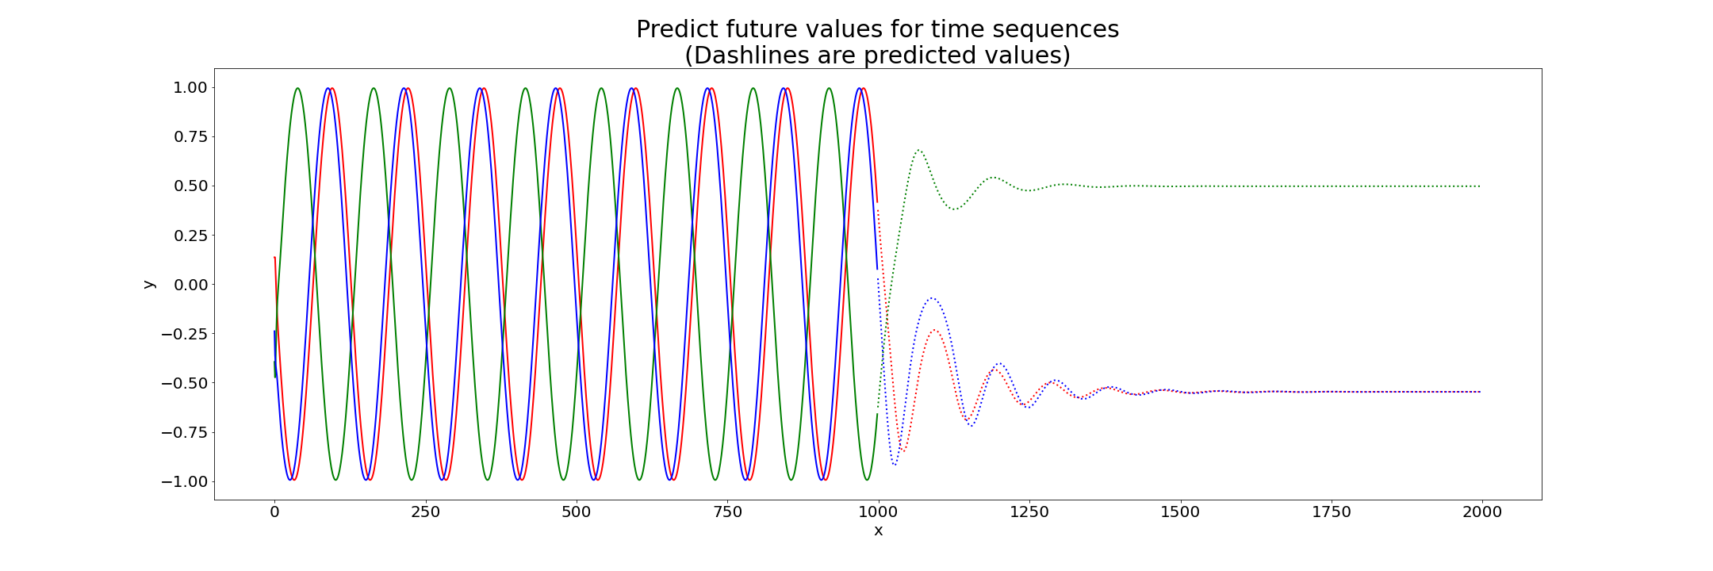
Predicted Graphs
Step-1
Step-2
Step-3

Slide 8
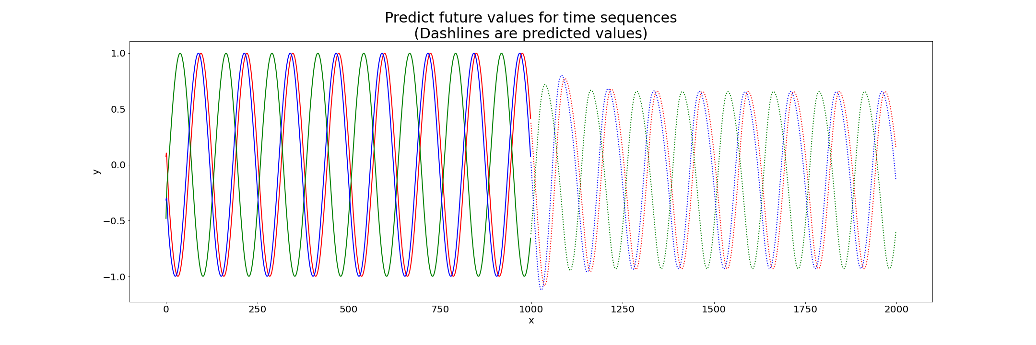
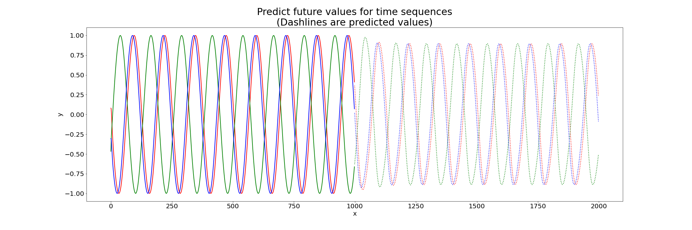
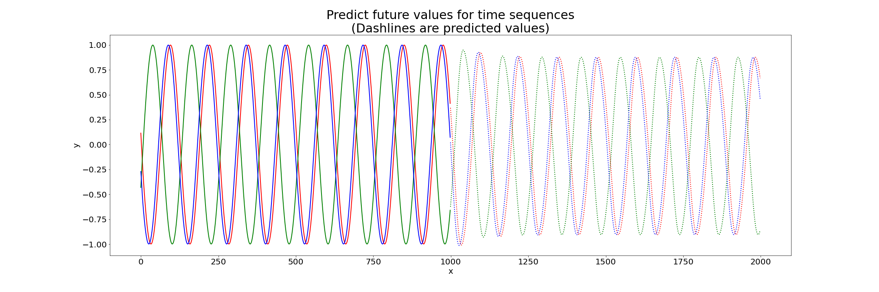
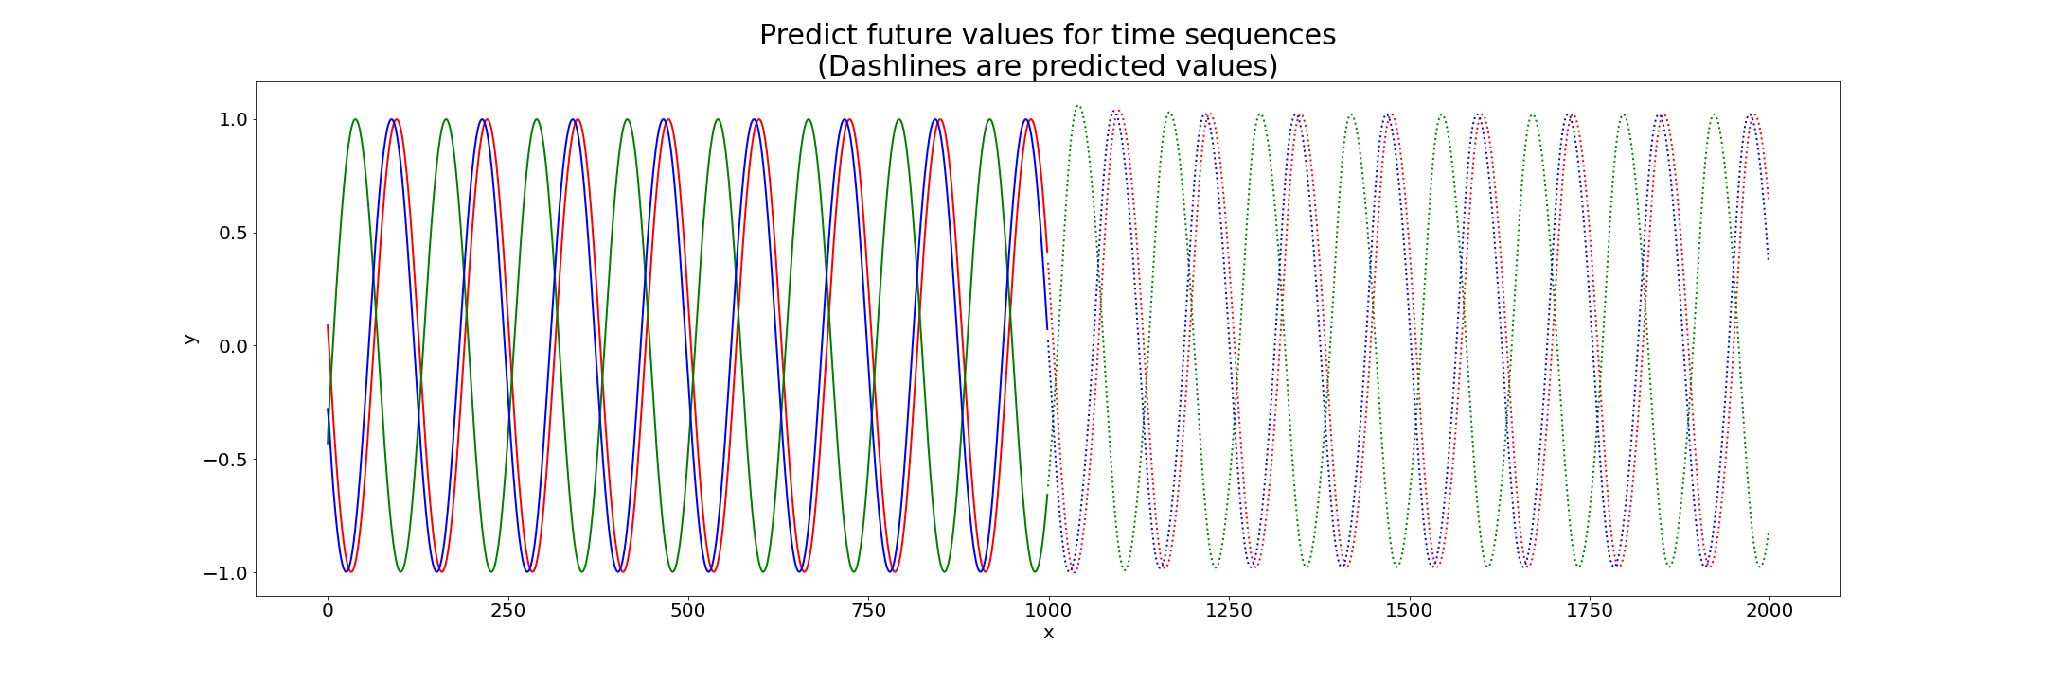
Step-4
Step-5
Step-6
Step-7

Slide 9
Thank you.

